Slide 1
Dr.Mohammed Al-Husban
Senior Lecturer, HCI Unit leader.

Slide 2
UX
User Research
user experience
information architecture
interaction design
content strategy
usability testing

Slide 3
Efficient Development..
Relies on the systems developer having a GOOD understanding of the stakeholders
Needs
Objectives
Context
! And.. Knowing what the technology can do!

Slide 4
The Focus of the development:
UCD
TCD
User = User Centred Design
Task = Task Centred Design
Content = Content Centred Design
CCD

Slide 5
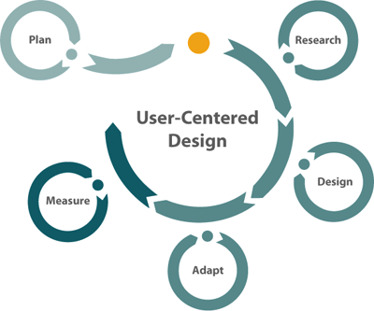
User Centred Design
Focus on the people who will use the
system, on their preferences and their
requirements:
1- Building models of the users, tasks
and systems
2- Iterative process
3- Prototyping and Evaluation by users

Slide 6

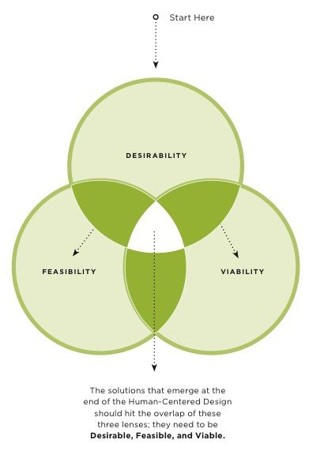

Slide 7
What can I easily build on this platform?
What can I create from the available tools?
What do I as a programmer find interesting?
Design is based upon a user’s :
abilities and real needs
context
work
tasks
values

Slide 8

What
Users
Want
USERS
Do anything to keep them happy

Slide 9

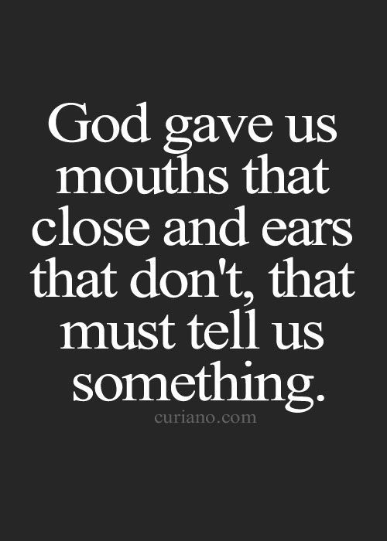
What Losers Want

Slide 10
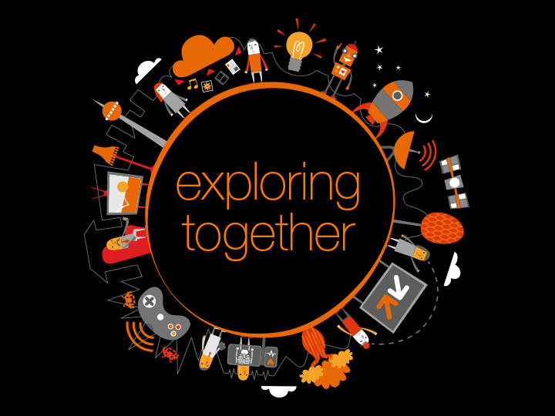
If you want to achieve the best UCD,
conduct a proper
User Research

Slide 11
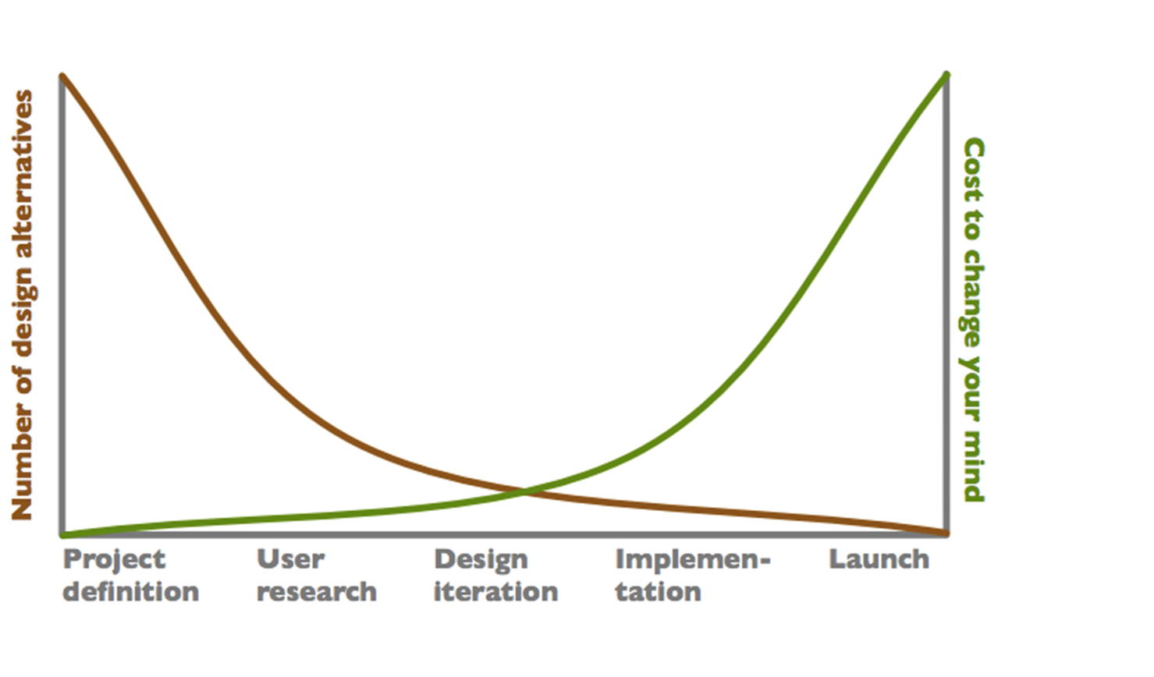
Why User Research?

Slide 12
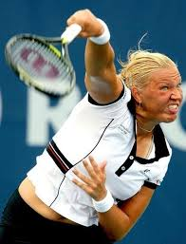
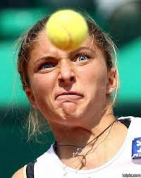
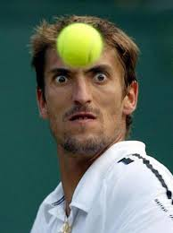

Understanding Users ..Who cares

Slide 13
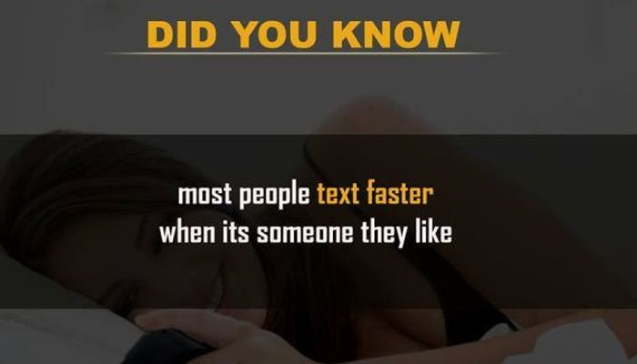
Human behaviour is complex

Slide 14
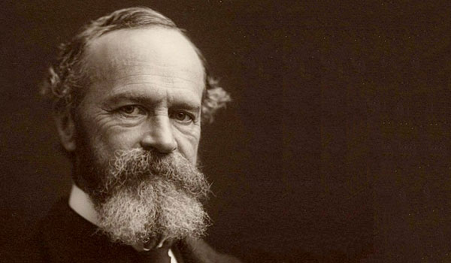
a person's thoughts and conscious reactions to events, perceived as a continuous flow.
William James (1890).

Slide 15
But most of times in UX projects, it is user researcher fault not being able to gather and understand user requirements.
XXXX

Slide 16
USERS
It is not as easy as you may imagine ……..

Slide 17
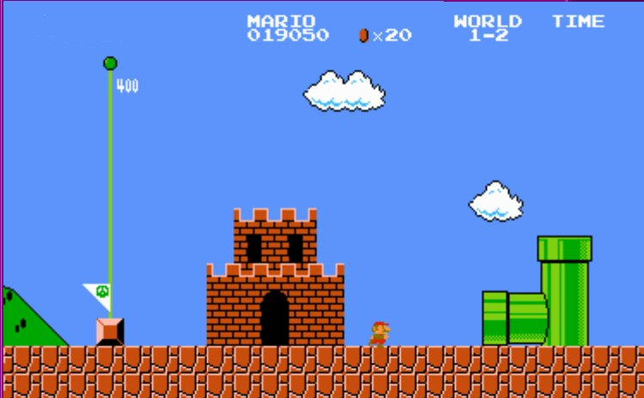
What is the ultimate goal of User Researchers?

Slide 18
USER GOALS
BUSINESS GOALS

Slide 19
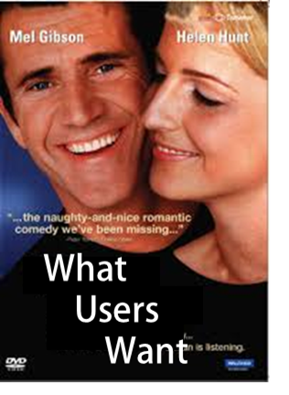
USERS
Do anything to keep them happy

Slide 20
£ 35,850

Slide 23
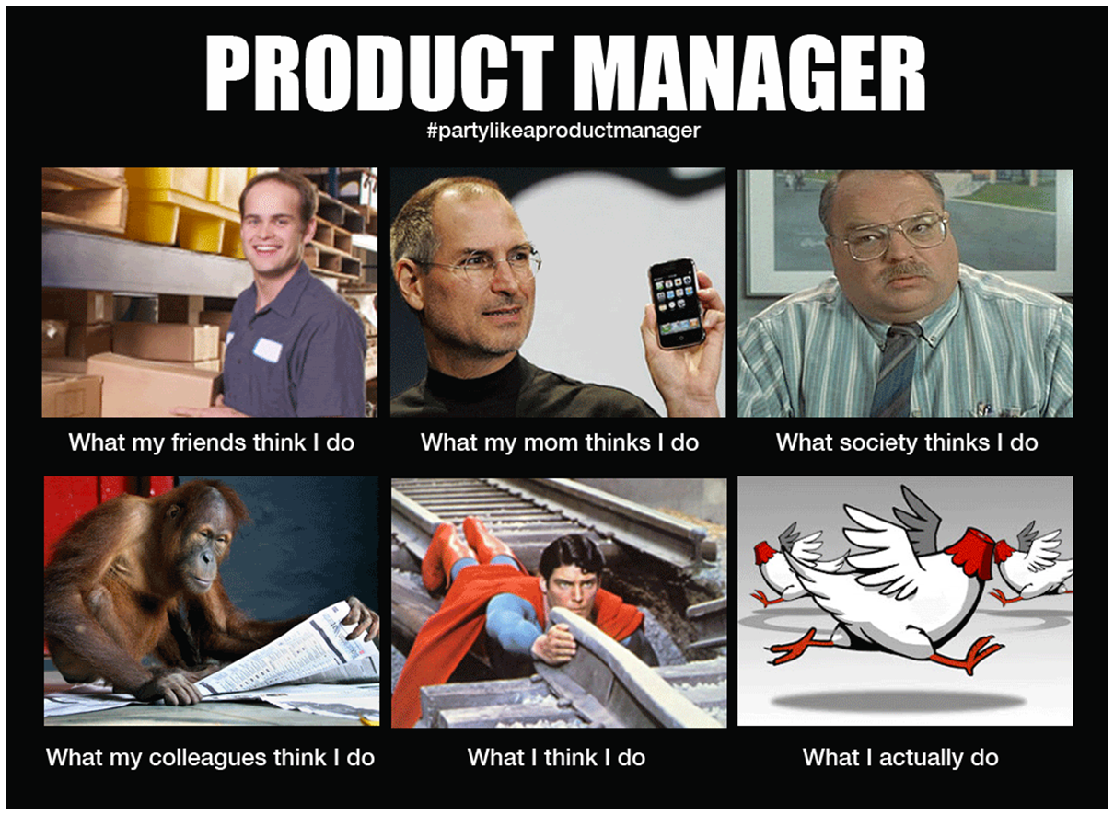
User Researcher Role

Slide 24
User Researcher: £32K annual or (£300 – £400) AVG per day
Planning, designing and conducting in-house usability testing sessions to support the design and development of government services
Leading the usability testing process from developing user recruitment briefs through to test moderation, analysis and report writing
Conducting in-house research to test new product and concept developments (including user requirements gathering and early stage concept and prototype testing, guerrilla research, and other approaches to ensuring the user need is fully understood in the service design)
Working with managers as required to devise appropriate research strategies to generate focused insights and to convert concepts into high quality stimulus material
Working closely with designers and developers to turn user data into actionable product/service requirements that feed into prototype development, and influence product direction
Managing ad-hoc qualitative/quantitative research projects such as proposition development, visual identity and customer experience mapping
Applying knowledge in human factors and the user- design process to product and service design in an iterative development environment
Presenting findings and related design/business recommendations and customer insights to senior decision makers
Managing day-to-day operations with a range of usability and market research agencies with accountability for schedules, value for money and deliverables
Promoting user centred design principles and best practice across the organisation

Slide 25
WHAT IS USER RESEARCH?
User Research focuses on understanding user behaviors, needs, and motivations through observation techniques, task analysis, and other feedback methodologies.
Design research describes any number of investigative techniques used to add context and insight to the design process.
Good user research provides actionable and testable insights into users’ needs.
User research helps us to understand how other people live their lives, so that we can respond more effectively to their needs with informed and inspired design solutions.

Slide 26
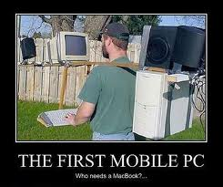
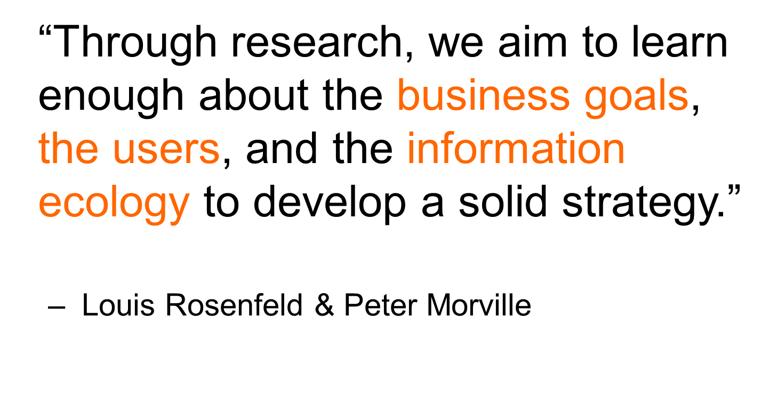
USER RESEARCH?
Information ecology is an emerging, loosely-defined field generally concerned with modelling information processes in human systems.

Slide 27
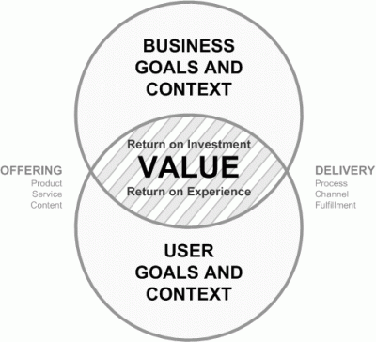
Remember…. User Research
User Goals
Business Goals

Slide 28
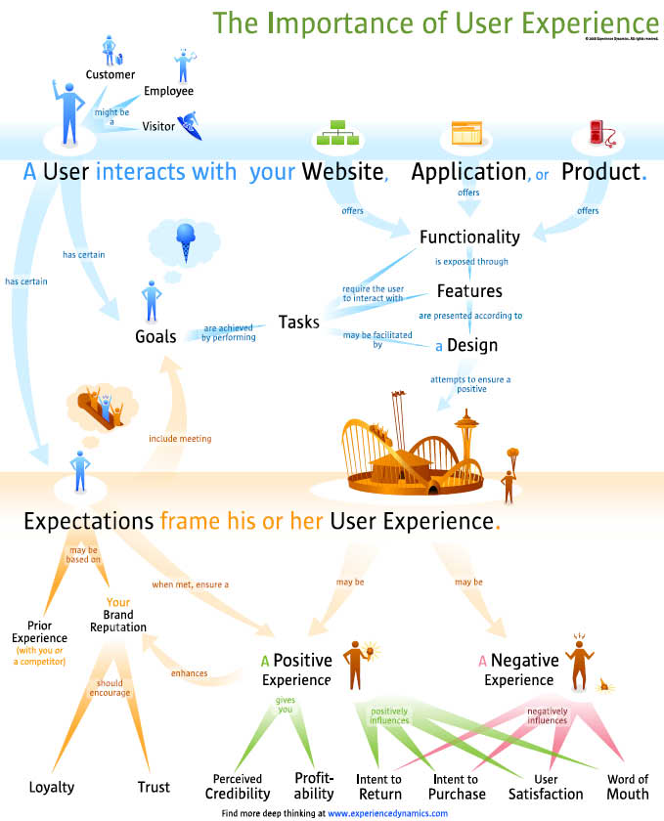

Slide 29
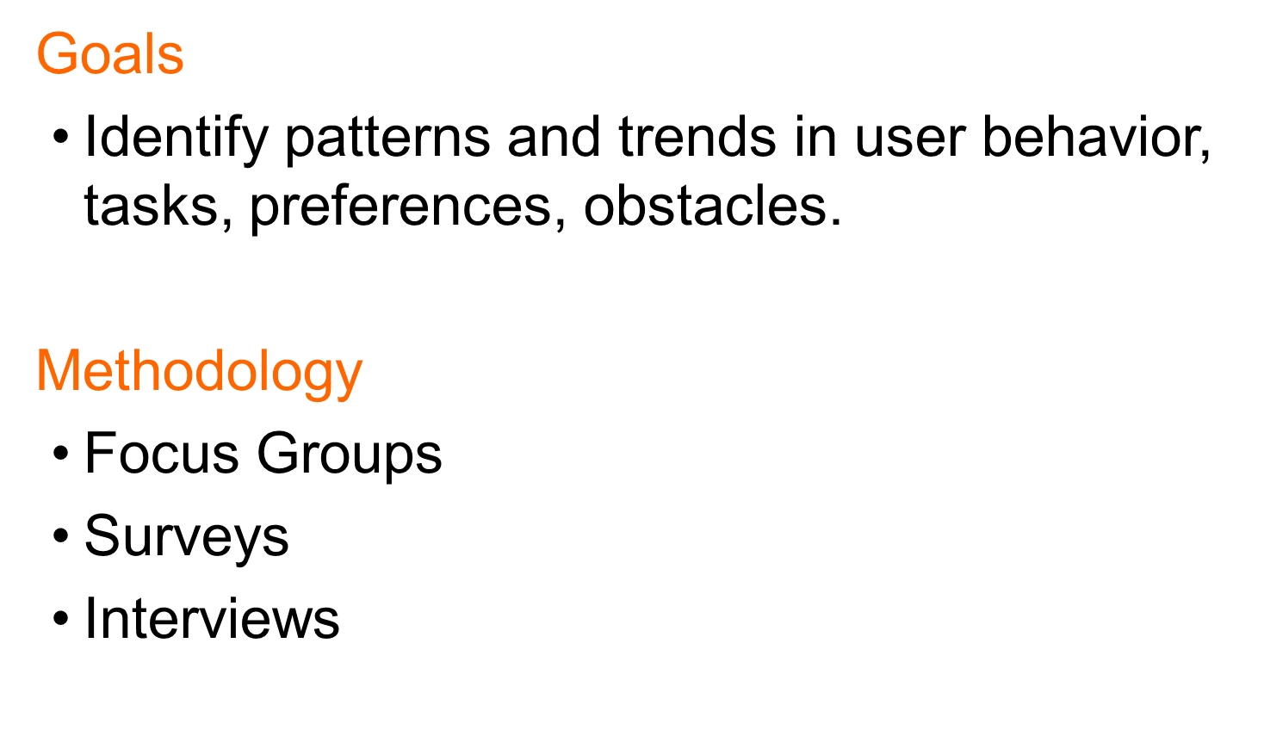

Slide 30
METHODS
http://www.nngroup.com/articles/which-ux-research-methods/

Slide 31
METHODS
http://www.nngroup.com/articles/which-ux-research-methods/

Slide 32
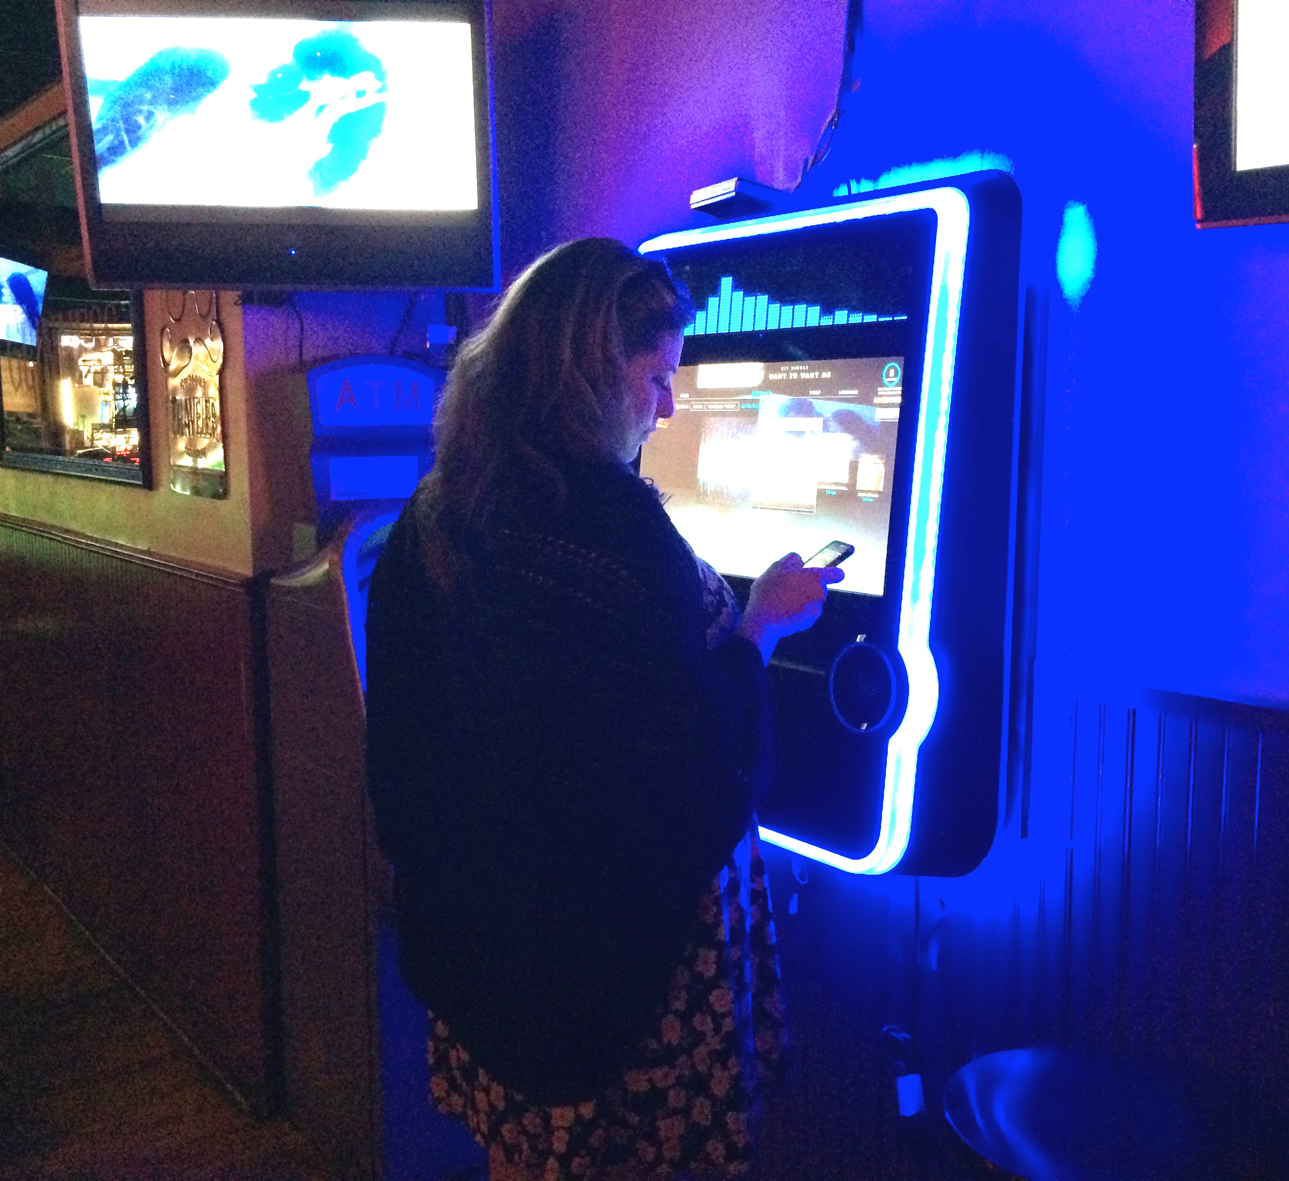
CONTEXTUAL INTERVIEWS
Researchers watch and listen as users work in the user’s own environment
PROS:
Qualitative, observed data
Provides insight:
Issues users are facing
Equipment they are working with
How their space is set-up
Type of internet connection , etc.
How long it takes to complete tasks
Presence of people willing to assist users
CONS:
Limited quantitative/measured data
Source: http://www.usability.gov/what-and-why/user-research.html

Slide 33
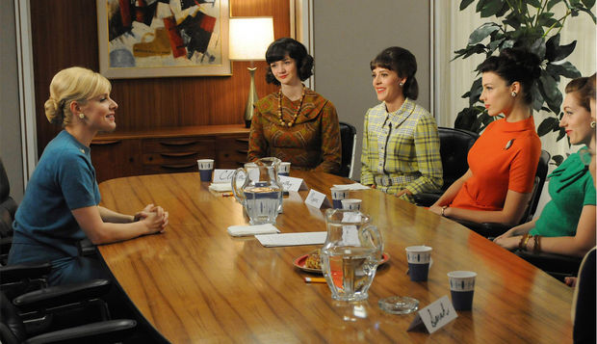
FOCUS GROUPS
A moderated discussion to learn about users’ attitudes, beliefs, desires, and reactions to concepts.
Typically 5-10 participants
Researchers usually select participants based on specific traits (e.g. age, ethnicity, occupation, etc.)
PROS:
Qualitative, observed data
CONS:
Don’t get to verify or observe reported experiences
TIPS:
Decide on topics and pre-test questions
Take notes and consider taping discussion
Plan to spend about two hours with the group
Source: http://www.usability.gov/what-and-why/user-research.html

Slide 34
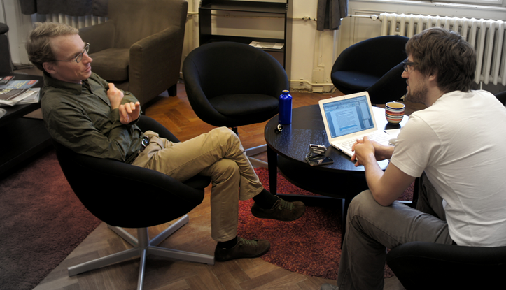
INDIVIDUAL INTERVIEWS
Probes attitudes, beliefs, desires, and experiences to get a deeper understanding of your users.
Most similar to focus groups
Talk to only one person at a time (can also be done over phone, IM, etc.)
PROS:
Have more time to discuss topics in detail
Do not have to worry about inevitable group dynamics
Can adjust your interviewing style to your interviewee
TIPS
Take place at start of the development cycle while you are developing or reviewing product objectives
Develop collection of contacts (“friendlys”)
Source: http://www.usability.gov/what-and-why/user-research.html

Slide 35
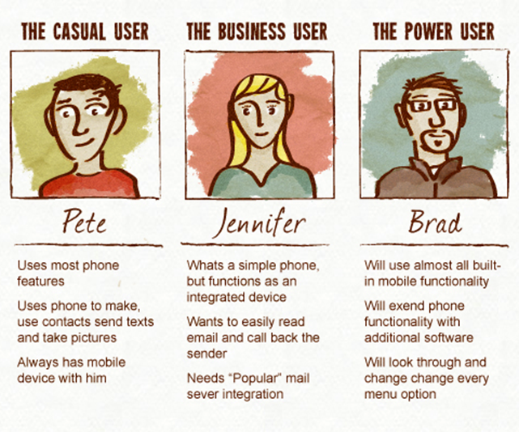
PERSONAS
Create reliable and realistic representations of your key audience segments for reference.
Should be completed early in the project to help inform site functionality, help uncover gaps, or highlight new opportunities
PROS:
Helps you evaluate new feature ideas
Ensure content is written to the appropriate audiences
Aids in uncovering universal features and functionality
TIPS:
Create groups based on qualitative and some quantitative user research and web analytics.
Give clear picture of user's expectations
Describe real people with backgrounds, goals, values
Source: http://www.usability.gov/what-and-why/user-research.html

Slide 36
ONLINE SURVEYS
A series of questions asked to multiple users; helps you learn about the people who use your product.
Done before a redesign, after new launch, ongoing, etc.
QUESTIONS TO ASK:
Ask how satisfied users are with your product
Ask if users would recommend your product to others
Include a mix of open-ended and “closed” questions
Ask if a respondent is willing to answer more in-depth questions in a follow-up survey or interview.
TIPS:
Keep your surveys as brief as possible
Provide estimated completion time, progress indicator
How satisfied users are with your site
Source: http://www.usability.gov/what-and-why/user-research.html

Slide 37
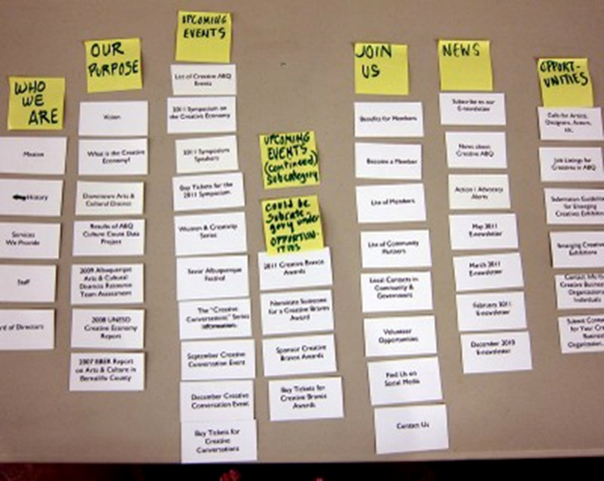
CARD SORTING
Participants organize topics into categories that make sense to them and they may also help you label these groups.
Can help evaluate the information architecture of a site
Builds structure for site; decide what goes on homepage
Helps you label categories and navigation
“Closed Sort” specifies certain categories, “Open Sort” does not.
TIPS:
Limit number of cards (30-40 max)
Randomize order of cards
Consider remote sorting
Consider an open sort as part 1 and a closed sort as part 2 of your process.
Notes:
Me: haven’t done it.

Slide 38
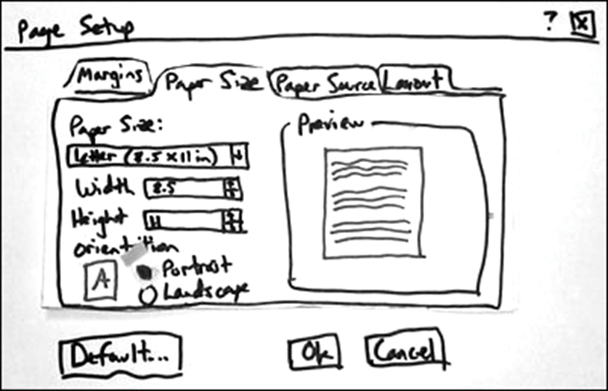
PROTOTYPING
Allows you to gather feedback from users while you are still planning and designing your product
Low-fidelity prototypes are often paper-based and do not allow user interactions.
Range from a hand-drawn to printouts
Quicker to create
Rough sketches may make users feel more comfortable suggesting changes
High-fidelity prototypes are generally digital and usually allow realistic user interactions
Collects true human performance data
Can be used to demonstrate actual products to clients, management
PROS:
Cheaper to make changes before any code has been written than to wait until after the implementation is complete.
Source: http://www.usability.gov/what-and-why/user-research.html

Slide 39
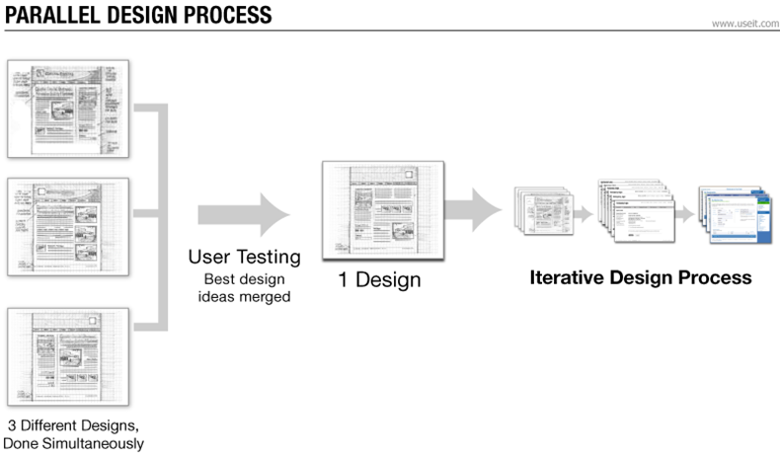
PARALLEL DESIGN
With the parallel design technique, several people create an initial design from the same set of requirements.
PROS
A range of ideas to be generated quickly and cost effectively.
Compresses concept development schedule.
Final design can benefit from all ideas proposed.
Case study results showed the improvement in measured usability from version 1 to 2 was 18 percent with traditional iterative design and 70 percent with parallel design
Notes:
ME: Different designs for homepage, etc.

Slide 40
FIRST CLICK TESTING
Examines what a test participant would click on first on the interface in order to complete their intended task
Can be performed on a functioning website, a prototype, or a wireframe
When users' first click is down the right path, 87% eventually succeed (vs. 46%)
TIPS:
Track each click.
Time how long it takes the user to make this click.
Compare two different designs (e.g. old and new)
After each task attempt, have participants indicate how confident they were they found the right location.
Notes:
ME: we did it with a prototype and found out what % were going to search, to see if we moved the needle

Slide 41
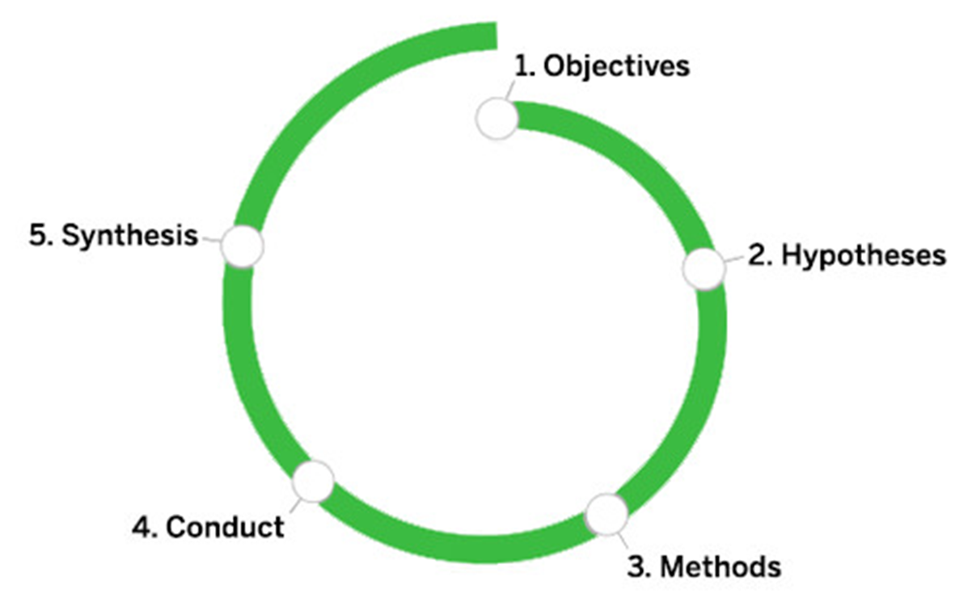
PROCESS
www.smashingmagazine.com/2013/09/5-step-process-conducting-user-research/

Slide 42
OBJECTIVES
Ask questions
“Who would share program clips?”
“How frequently would viewers share clips?”
“Why would people choose to share clips?”
Identify overall objective
You need to be able to reach that objective in the time frame you have allotted for the research.
Document in a one-pager.
Source: www.smashingmagazine.com/2013/09/5-step-process-conducting-user-research/

Slide 43
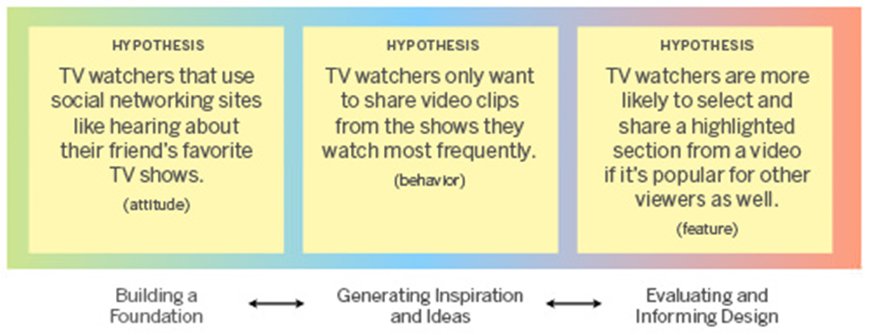
HYPOTHESES
Creates awareness to help minimize bias
Helps you select the right methods
Use your early hypotheses to help communicate what you’ve discovered through research.
E.g. “We believed [A], but discovered [B].”
The more the merrier
Source: www.smashingmagazine.com/2013/09/5-step-process-conducting-user-research/

Slide 44
METHODS
Building a Foundation
Surveys, observational or contextual interviews, and market and trend explorations
Addressing unanswered questions about user base
Generating Inspiration and Ideas
Card sorting, paper prototyping and other participatory design activities
Feedback is not about refining, but opening up new possibilities
Evaluating and Informing Design
Usability testing, heuristic evaluations, cognitive walkthroughs and paper prototyping
Refine design comps, simulations and code prototypes

